Slide 1

AMERICA’S GUN CULTURE
ADVA ASRAF
OLGA KRIYOKOV
DAV 5400 - Analytics Programming
Final project
Prof. James Tooper

Slide 2

AGENDA
Introduction
Motivation
Data Source
Research Questions
Analysis
Insights

Slide 3
INTRODUCTION
1. The right to bear arms and gun control issues are very controversial
2. Every year, thousand of deaths in the U.S. are caused by gun violence incidents
3. Gun sales in the U.S. sum up to millions of dollars every year
4. In 2018, more people have died from firearm injuries in the U.S
5. The U.S. has 120.5 guns per 100 people
More info is availble at: https://everytownresearch.org/gun-violence-america/

Slide 4
MOTIVATION
1. Israel is a State that has suffered many gun violence incidents, usually due to terrorism
2. Special license to bear arms
3. Most of U.S. gun violence incidents occur due to personal conflicts and crime
4. Analyzing the tendency of gun violence in the U.S. to check correlation between gun sales and number or permits
5. Predicting gun sales for 2019

Slide 5
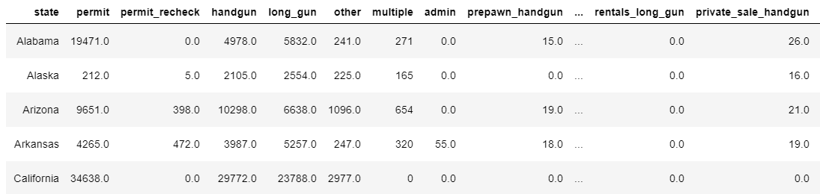
DATA SOURCE 1
Evolution of gun sales between the years of 2007-2018
Format: CSV file
Source: Kaggle.com
Data: contains data on types of weapons( hand gun, long gun) and their permits in different U.S. states.

Slide 6
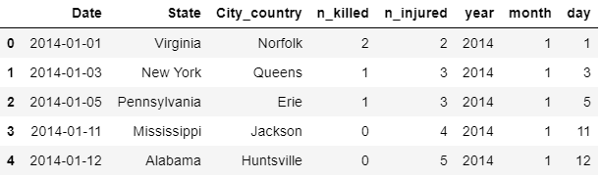
DATA SOURCE 2
Gun Violence Data Archive
Format: Web scrapping into a CSV file
Source: GunViolenceArchive.com
Data: The Gun Violence Archive (GVA) - non-profit organization. Provides an access to gun-related violence data in the U.S.
All of the gun violence incidents that took place between the years of 2013- 2018 are recorded.

Slide 7
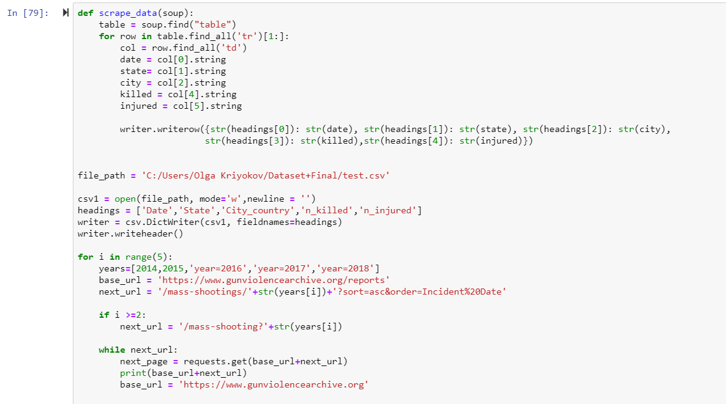
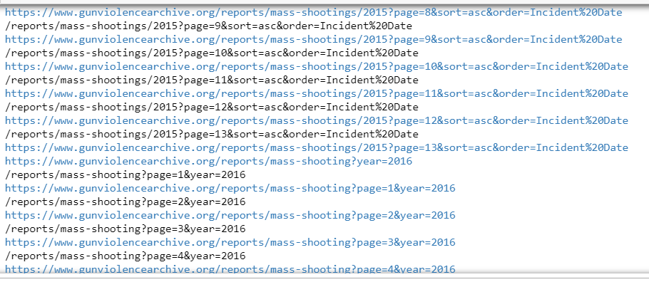
Web Scraping

Slide 8
Let’s Explore! Research Questions

Slide 9
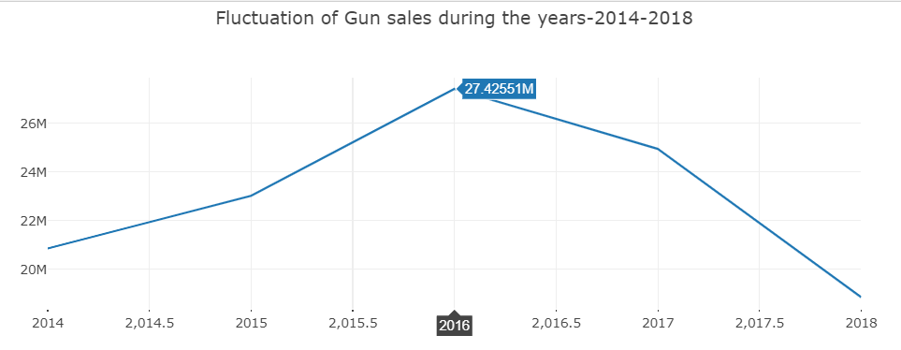
1. How have gun sales changed between the years of 2014- 2018
2014- 2018 - gun sales have gone down ever since 2016, in which gun sales were the highest in – 27.43 M.

Slide 10
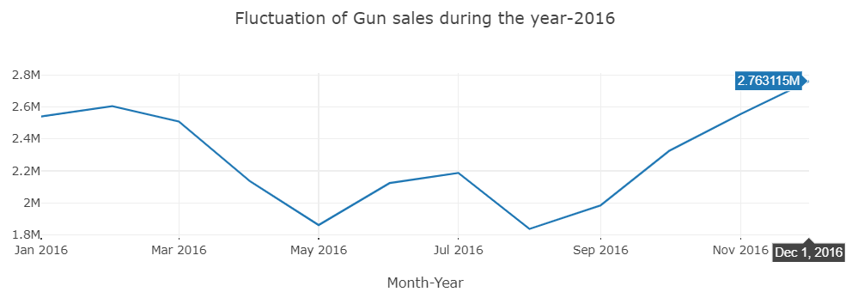
1. How have gun sales changed between the years of 2014- 2018
2016- The peak point was in December, while the lowest point was in May

Slide 11
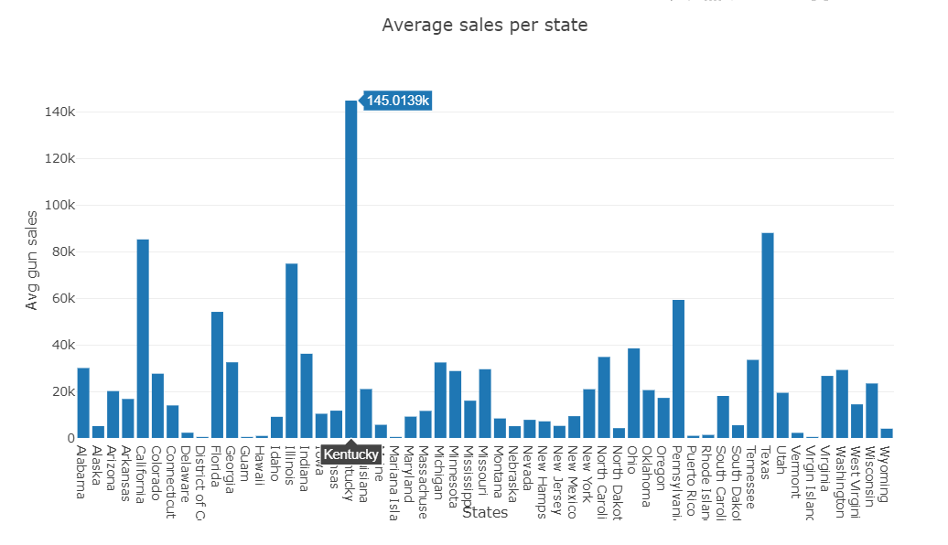
1.1 Average sales in states
Kentucky has the highest average gun sales with more than $ 140k
Texas was the second best with sales of $88.12K, followed closely by California with average sales of $ 85.33K

Slide 12
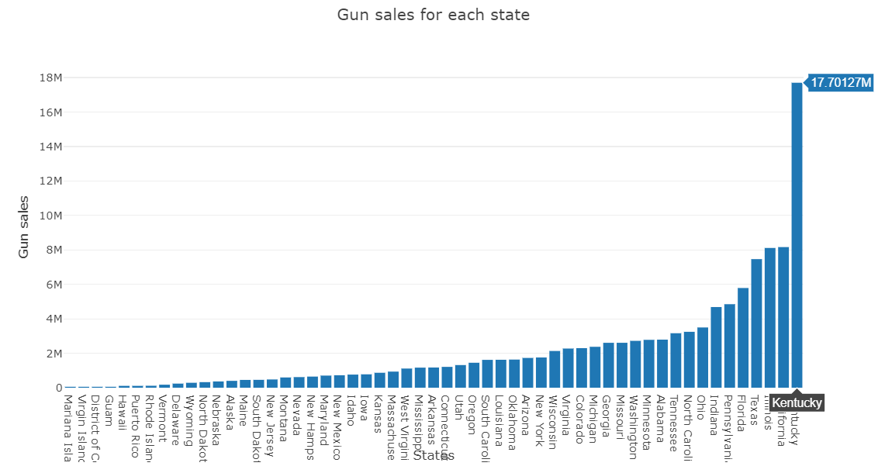
2. Which states have the highest number of guns sales between the years of 2014- 2018
Top gun selling State is Kentucky, followed by Texas, Indiana, Tennessee and Washington, respectively.

Slide 13
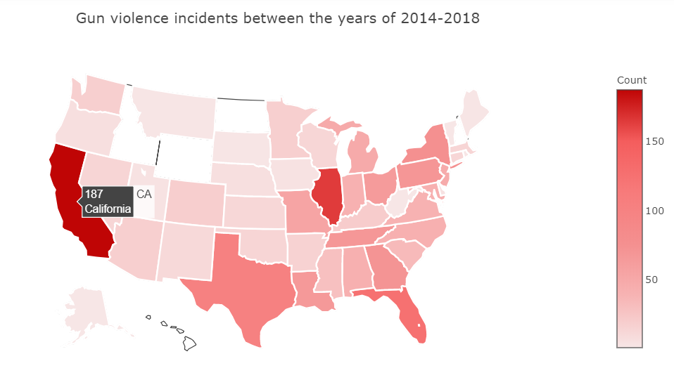
3. Which states have highest gun violence incidents between the years of 2014- 2018?
Top 5 states:
California 187
Illinois 164
Florida 125
Texas 102
New York 76

Slide 14
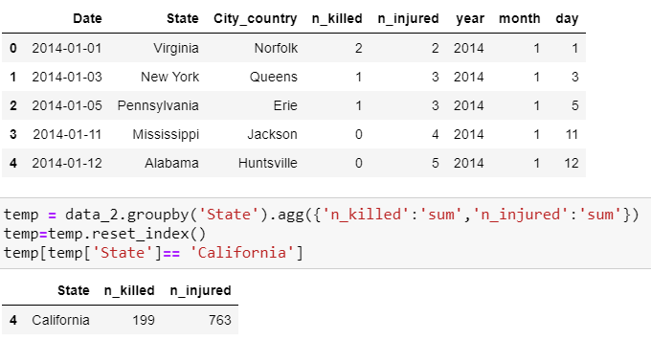
3.1. How many inhabitants were killed and injured in California
California
187 incidents:
199 people killed 763 were injured.

Slide 15
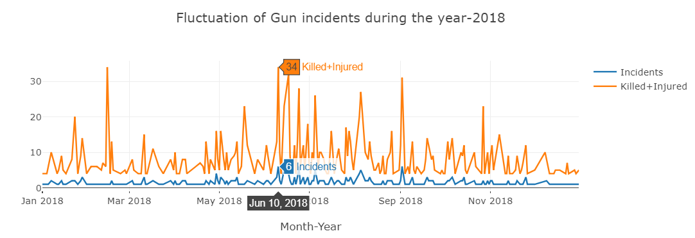
4. How have gun incidents occurrence changed in 2018?
2018 - peak was on June 17. 5 people were injured and 29 were killed. 6 Incidents occurred too. In states of : Florida, California, Indiana, Illinois.

Slide 16
4.1 Which State had the most severe gun violence incident
Most severe gun violence incident is Nevada.
Happened in Las Vegas on October 1, 2017

Slide 17
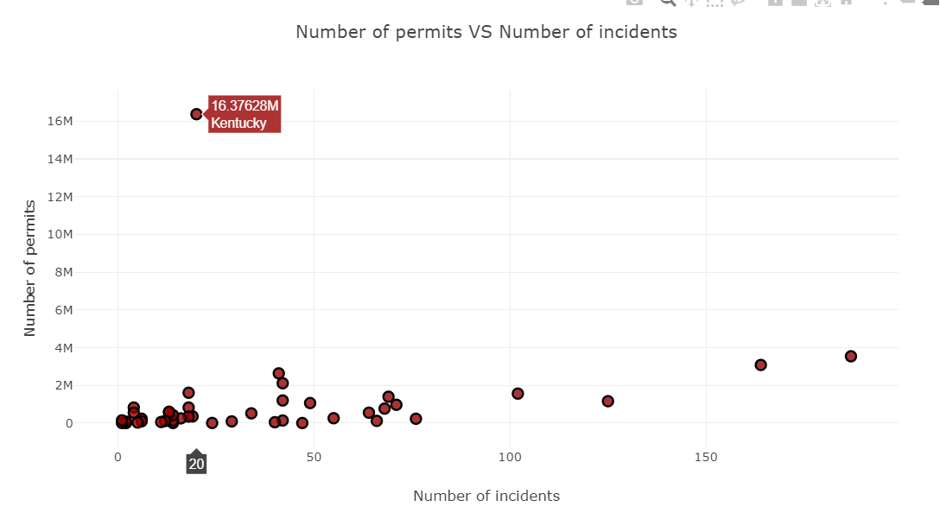
5. Is there a correlation between the number of permits allocated to each State and the number of gun violence incidents that occurred in that State?
There is correlation.
The correlation coefficient indicates this positive linear relation is not strong.

Slide 18
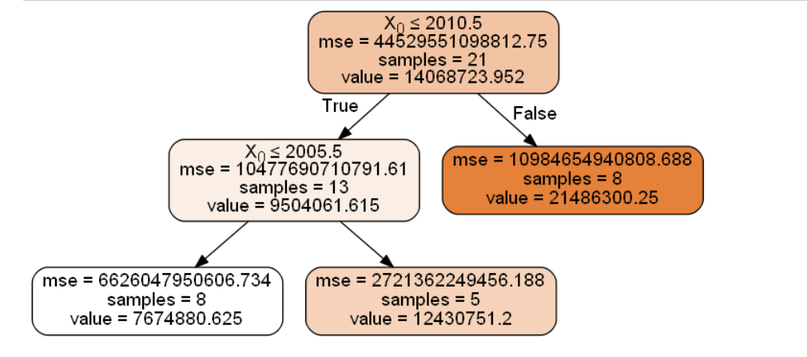
6. Are gun sales likely to increase in 2019
Training Set: Previous years
19

Slide 19
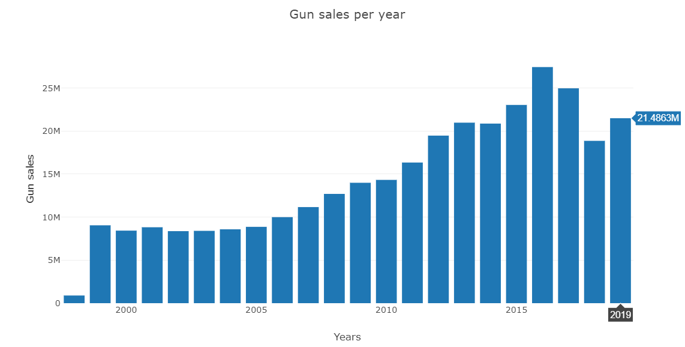
6. Are gun sales likely to increase in 2019
Estimated gun sales for 2019: Increase by 1.67 M
20

Slide 20
Summary
22

Slide 21
1. Between the years of 2016 -2018 there is an improving trend on selling less guns, but as we predicted using a tree, the sales will increase in 2019 by 12% .
2. The top 4 States with the highest number of casualties and injured people are:
Nevada, Florida, Texas, California.
3. California – has the highest number of incidents among the states
4. Los Angeles is the city that had the highest number of gun violence incidents - 14% of total CA
5. Long guns – are sold the most

Slide 22
Thank you! Questions?
22

